Slide 1

PLEASE SIGN CARD
DBI OF MOSHI GRADUATION
APRIL 5, 2014

Slide 2

Revelation: Ch. 8-11 Angels And Trumpet
“The Two Witnesses”

Slide 3
Review of the Sixth Trumpet
A Voice
Release of Angels
Horses and Horsemen
The Condition of the World
The Cloud Robed Angel
The Reinstating of the Jew

Slide 4
The Two Witnesses
Revelation 11:3-13

Slide 5
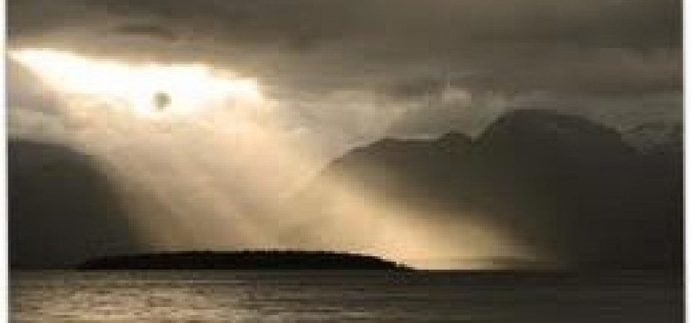
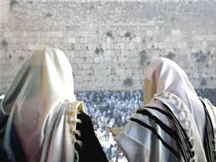
Their Outstanding Circumstance

Slide 6
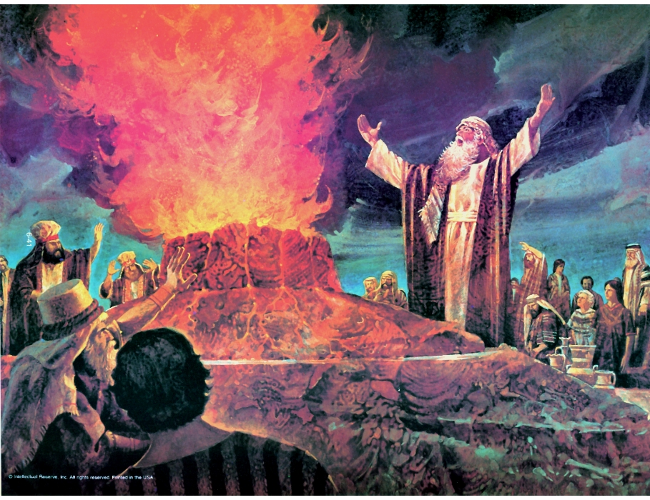
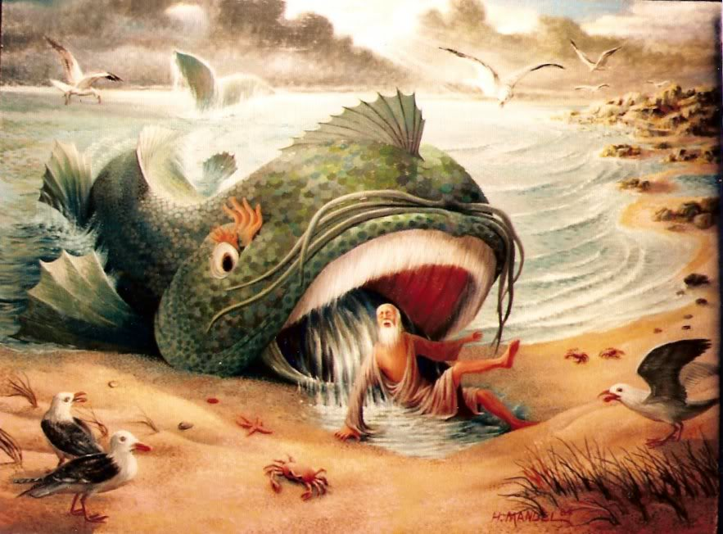
Their Ordained Commission
They are Witnesses

Slide 7
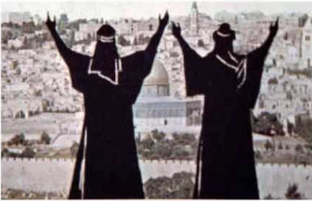
Their Ordained Commission
They are Human Witnesses

Slide 8
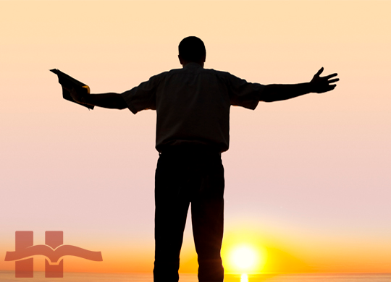
Their Ordained Commission
They are Merciful - FLEE!

Slide 9
Who are the Two Witnesses?
Ordained of God (Having God’s Power)
Witnesses Against Sin (rebuking, exposing, judging)
Belong to the One True God
Human
Merciful

Slide 10
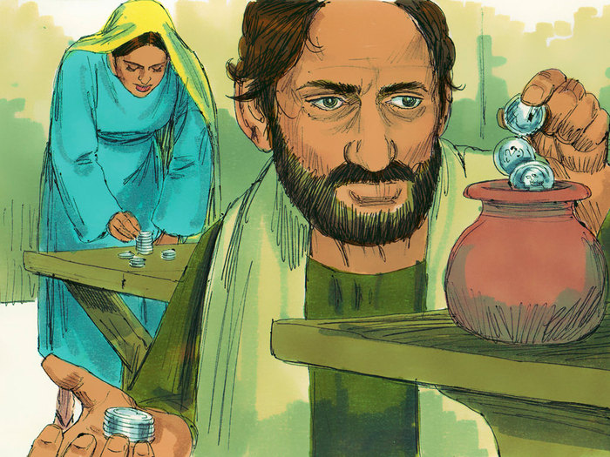
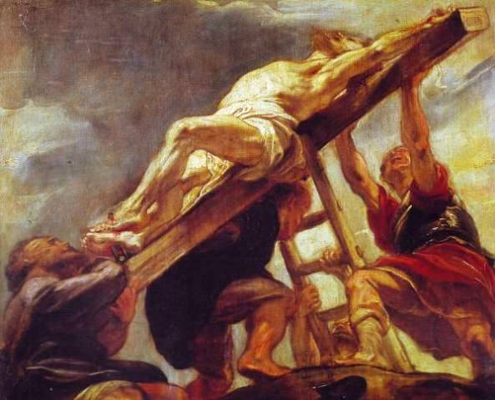
The Times of the Witnesses
Matthew 5:44 ...bless them that curse you, do good to them that hate you, and pray for them which despitefully use you, and persecute you;

Slide 11
The Work of the Witnesses
REPENT
OR BE
JUDGED

Slide 12
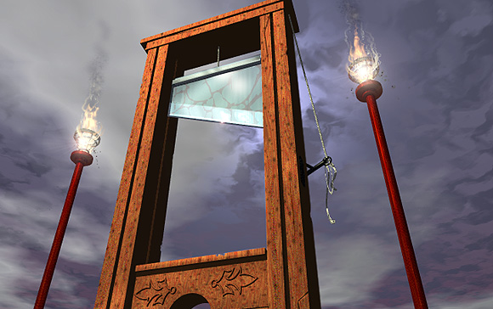
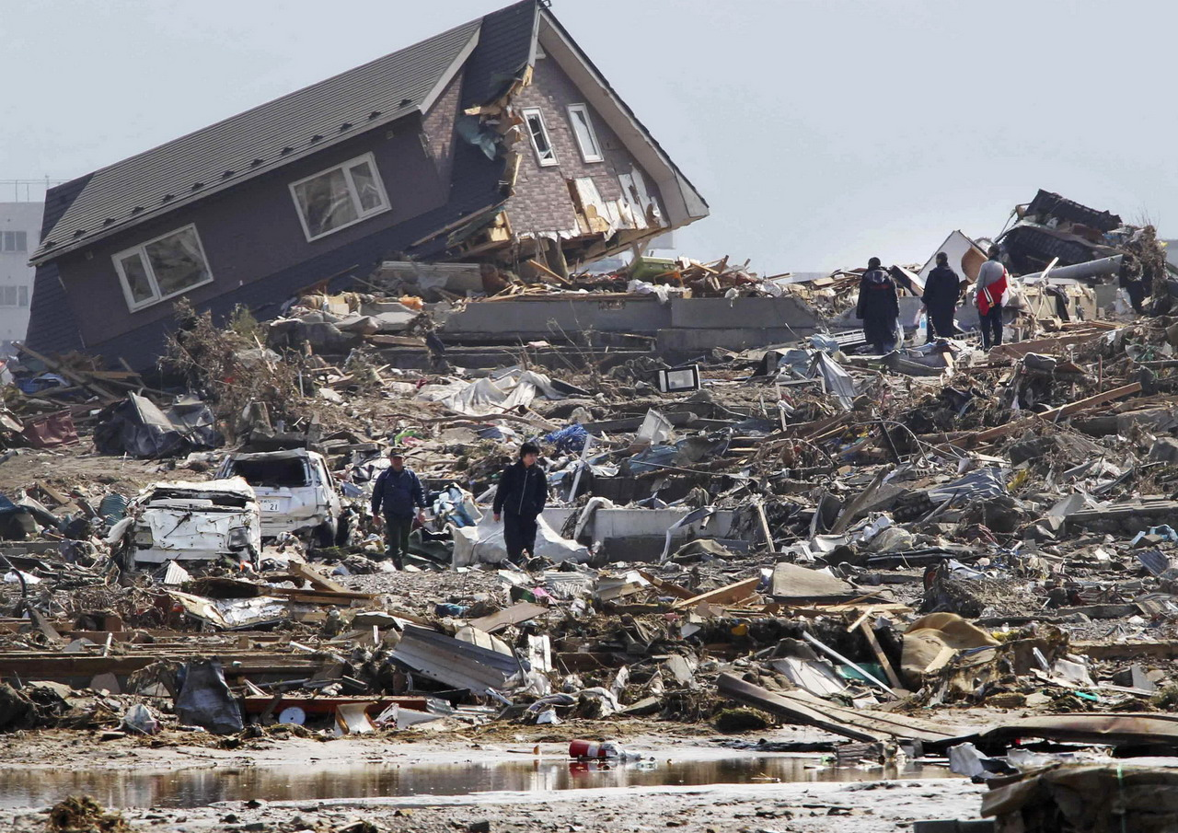
The End of the Witnesses
Death the Expires (not final!)

Slide 13
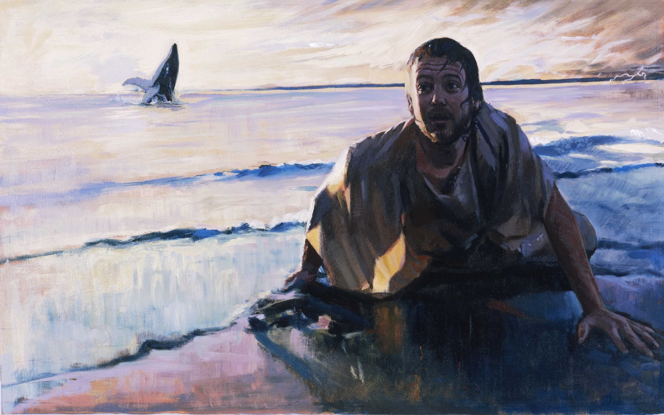
When God Tells Us What to Do...

